Slide 1
CIA 1- REVISION
10-3-2025

Slide 2

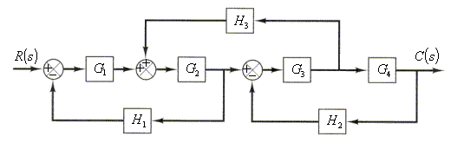
Problems in Block Diagram Reduction

Slide 3
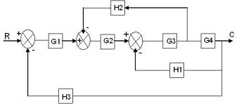
Problems in Block Diagram Reduction

Slide 5

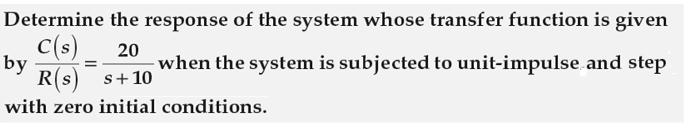






Problems in Time Response Analysis

Slide 6









Problems in Time Response Analysis

Slide 7
For a UFB system, for the E_{ss} to be > 1/15 for unit ramp I/P, find the value of k

Slide 8
Solution:

Slide 9
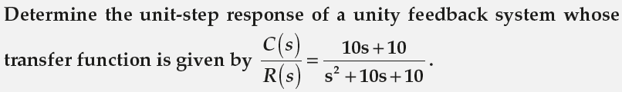
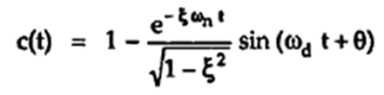

Time response analysis
Find damping ratio, natural frequency and the unit step response.
FORMULAE:

Slide 10
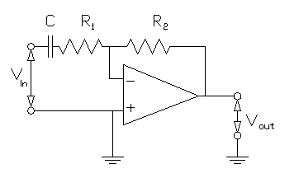
Derive the model….

